Slide 1


Analysis of Algorithms
LZW Compression Visualizer
Semester: Spring 2026 | Project Presentation
Student:
Instructor:

Slide 2
Course Learning Outcomes (CLO)
Code | Bloom’s Level | Learning Outcome Description
1.1 | Understand | Understand fundamental algorithms and explain design strategies.
2.1 | Implement | Implement algorithms, compare empirically, and solve real-world problems.
3.1 | Analyze | Analyze time and space complexity using asymptotic notations.

Slide 3


Introduction to LZW
What is LZW Compression?
LZW (Lempel–Ziv–Welch) is a Lossless data compression algorithm. It reduces file sizes without losing a single bit of information.
Design Strategy: Dictionary-Based Greedy Approach.
•
Identifies repeating patterns in data.
•
Replaces variable strings with short codes.
•
Builds its own dictionary dynamically.

Slide 4
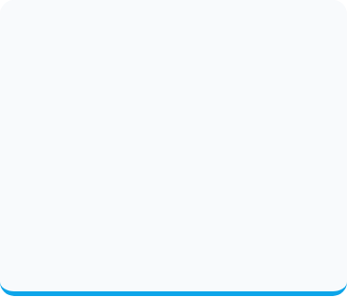
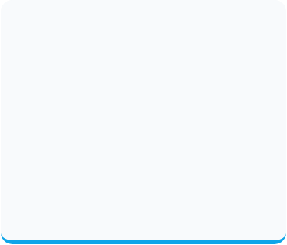



Basic Working Idea
Initialization
Pattern Matching
Dynamic Growth
Starts with a dictionary containing 256 standard ASCII characters (0-255).
Scans input and tries to find the longest substring already in the dictionary.
When a new pattern is found, it's added to the dictionary with a new code.

Slide 5
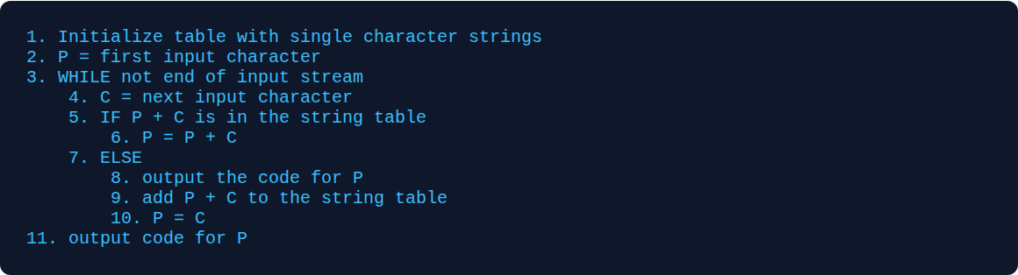
Algorithm Pseudocode

Slide 6


Code Implementation
The implementation uses JavaScript to handle dynamic dictionary objects. Key features include:
•
Modular `lzwCompress` function.
•
Efficient hash-map lookups for patterns.
•
Real-time dictionary expansion.

Slide 7
Validation: Test Cases
Input String | Expected First Codes | Actual Output | Status
ABABABA | 65, 66, 128, 130... | [65, 66, 128, 130, 65] | PASSED
AAAAAAAAA | 65, 128, 129... | [65, 128, 129, 130] | PASSED
ABCD | 65, 66, 67, 68 | [65, 66, 67, 68] | PASSED

Slide 8
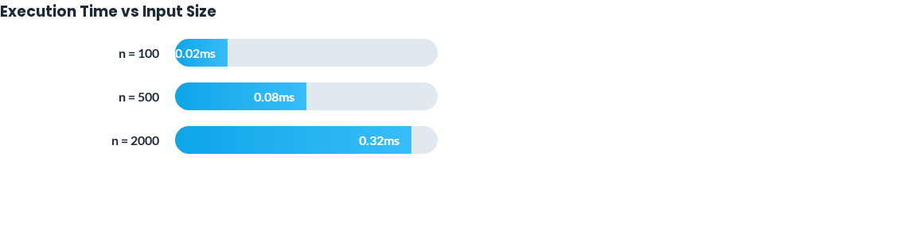
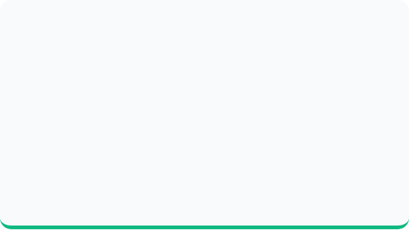
Empirical Results (CLO 2.1)
Observations
The execution time increases linearly as the input size grows. This validates the $O(n)$ time complexity. Compression ratio improves significantly on files larger than 1KB with repeating patterns.

Slide 9

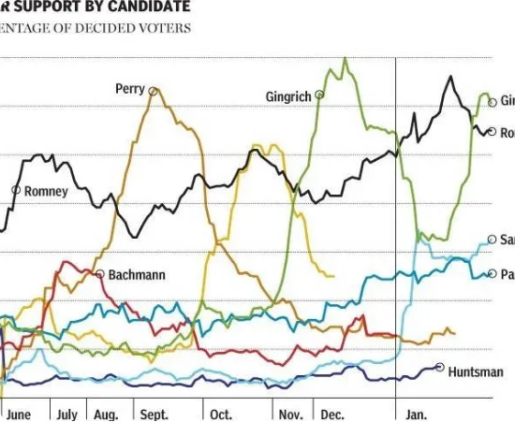
Performance & Growth Trend
•
Linear Trend: Time complexity remains consistent across random and pattern-heavy data.
•
Dictionary Expansion: Space usage grows at most O(n) beyond initial table.
•
Peak Performance: Best observed during character repetition (Ratio > 70%).

Slide 10


Complexity Analysis (CLO 3.1)
Time Complexity
Space Complexity
•
Worst Case: $O(n)$ - Scans all $n$ chars.
•
Dictionary: Grows linearly with n.
•
Best Case: $\Omega(n)$ - Matches existing patterns.
•
Total Space: Bounded by input size + initial ASCII table.
•
Justification: Each char is visited once; Map operations are O(1).

Slide 11

Real-World Applications
PDF Files: Standard stream compression.
GIF Format: Compressing pixel color data.
Unix Compress: System-level file reduction.
Trade-offs: High Speed vs Memory. LZW is faster than Huffman but needs more memory for the dictionary.

Slide 12
Conclusion
LZW is a highly efficient, single-pass algorithm ideal for repetitive data. This project successfully mapped the algorithm's greedy strategy to measurable execution metrics and complexity bounds.
GitHub: github.com/hamzabashir7786
LinkedIn: linkedin.com/in/hamzabashir7786
References: Welch, T. A. (1984). High-performance data compression.

Slide 13




Image Sources
https://static.vecteezy.com/system/resources/previews/003/809/954/non_2x/digital-binary-code-data-background-computer-numbers-technological-concept-vector.jpg
Source: www.vecteezy.com
https://static.vecteezy.com/system/resources/previews/066/330/747/non_2x/programming-code-executing-software-ui-on-computer-display-in-apartment-office-close-up-shot-of-coding-application-on-pc-screen-used-to-write-and-test-code-in-modern-living-room-photo.jpg
Source: www.vecteezy.com
https://365datascience.com/resources/blog/thumb@1024_2018-07-1-Bad-chart-example.webp
Source: 365datascience.com
https://www.coolutils.com/blog/wp-content/uploads/2025/08/unnamed.jpg
Source: www.coolutils.com

